Slide 1

Module 1
Overview of the Data Mining Process
Notes:
Guidelines
Use section headers to chunk content in your presentation.
Use the same style of section header throughout your presentation.
Keep your title to no more than 2 lines.

Slide 2

Example: EDA
Notes:
Guidelines
Use a title slide at the beginning of your presentation. There are 9 variations of title slides to choose from.
If you will have a series of slideshows, we recommend using the same style of title slide for each presentation.
Keep your title to no more than 2 lines.
Do not change the font style or font size of the title or subtitle.

Slide 3
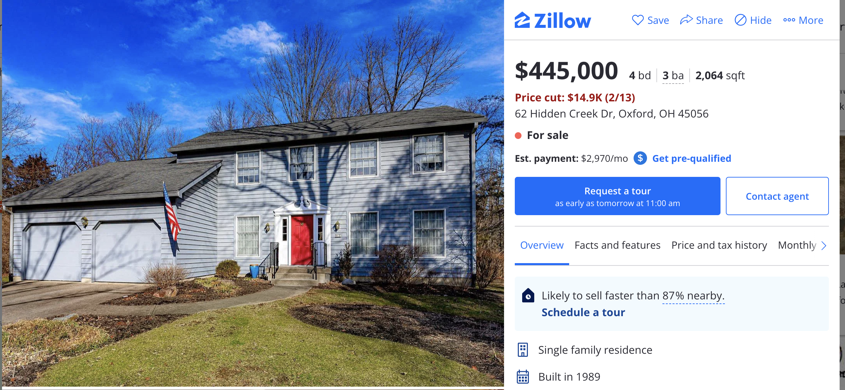
End-to-End DM Project
Zillow is a popular online real estate information website
One of the attractions to Zillow is the “Zestimate”
You are tasked to build a model of housing prices in California

Slide 4
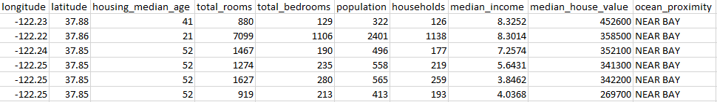
STEP 1: Purpose
Model median home values to predict the median value of homes.
We want to extract information from historical values.

Slide 5
STEP 2: Obtain the data
We already have "labeled" data ready for analysis

Slide 6
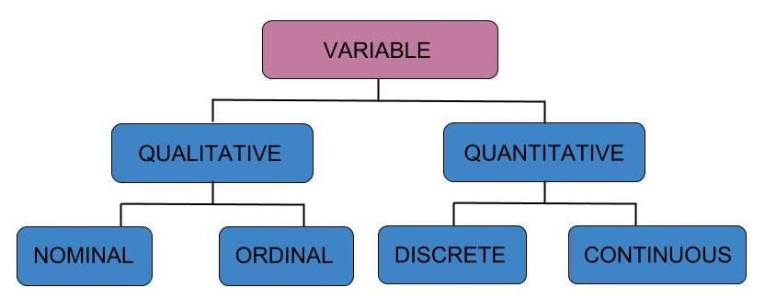
Variable Types
Numeric: float64, int64, int8
Categorical: O, category

Slide 7
Python
Notes:
Guidelines
Use a title slide at the beginning of your presentation. There are 9 variations of title slides to choose from.
If you will have a series of slideshows, we recommend using the same style of title slide for each presentation.
Keep your title to no more than 2 lines.
Do not change the font style or font size of the title or subtitle.

Slide 8
STEP 3: Exploratory Data Analysis
The shape of the data.
Unusual observations.
Missing values.
Highly skewed variables.
Categorical variables with a single value or with too many values.
Low occurrences of levels (categories) of a categorical
Relationships

Slide 9
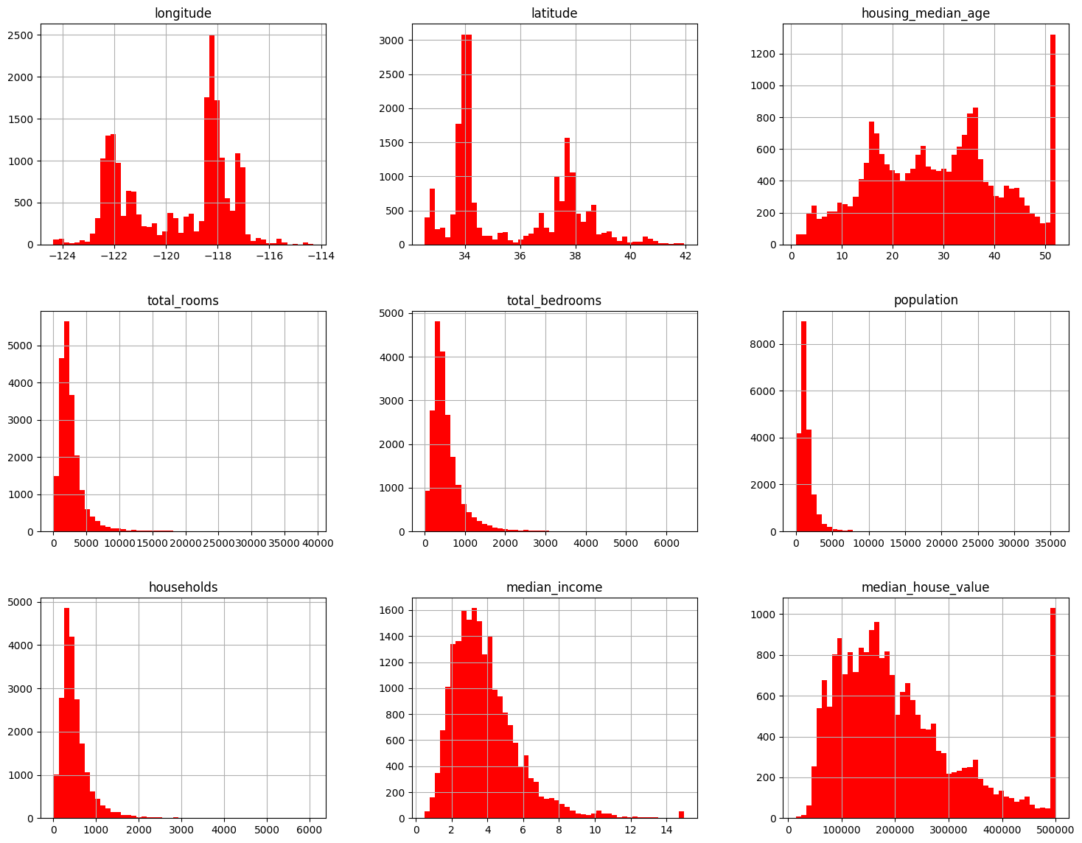
STEP 3: EDA
a) Statistical and Graphical Summaries

Slide 10
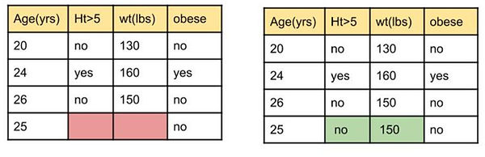
STEP 3: EDA
b) Missing Values and Imputation

Slide 11
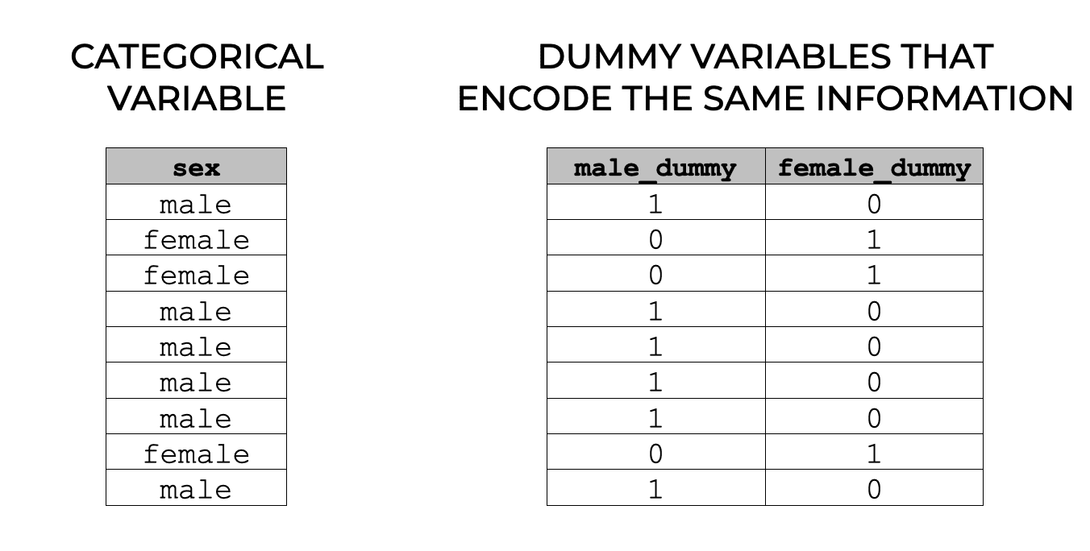
STEP 3: EDA
c) Encoding

